Slide 1


Number guessing game
Team members- Manichand (2010030455)
Dileep(2010030416)
Harsha vardhan (2010030173)
Prakash(2010030533)

Slide 2
OUTLINE
ABSTRACT
FLOW CHART
GITHUB COMMITS
implementation
REFERENCES

Slide 3
ABSTARCT
A number guessing game is a simple guessing game where a user is supposed to guess a number between 0 and N in a maximum of 10 attempts.
The game will end after 10 attempts and if the player failed to guess the number, and then he loses the game.

Slide 4
FLOWCHART

Slide 5
START
Genarate random integer between 1 and 100
Input guess number
Guess==
random
Guess
>
random
NO
YES
Print “Guess is too high”
Input guess
YES
NO
Print “guess is right you win!”
Print”guess is too Low”
END

Slide 6
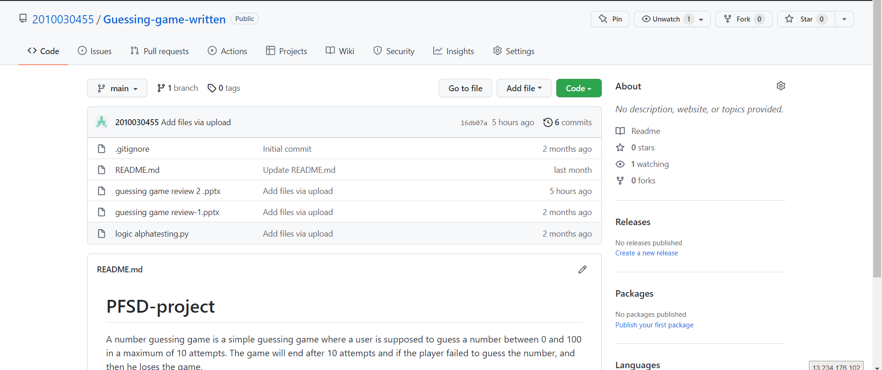
Github commits

Slide 7
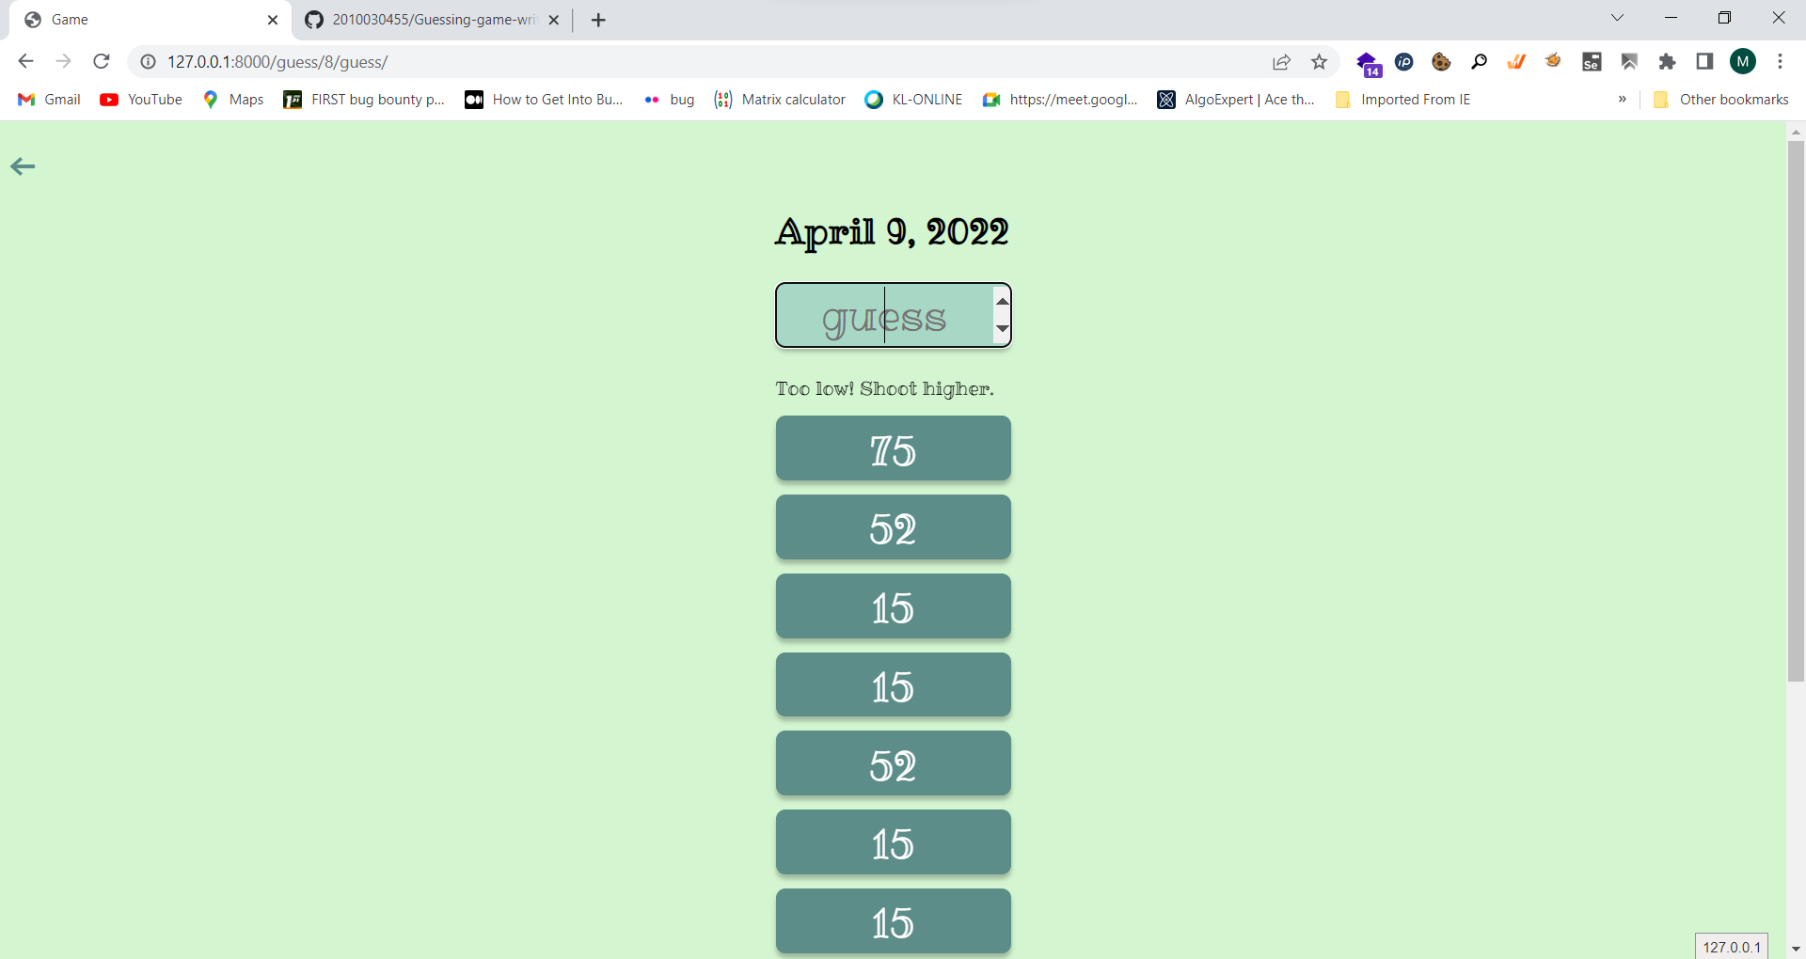
implementation

Slide 8
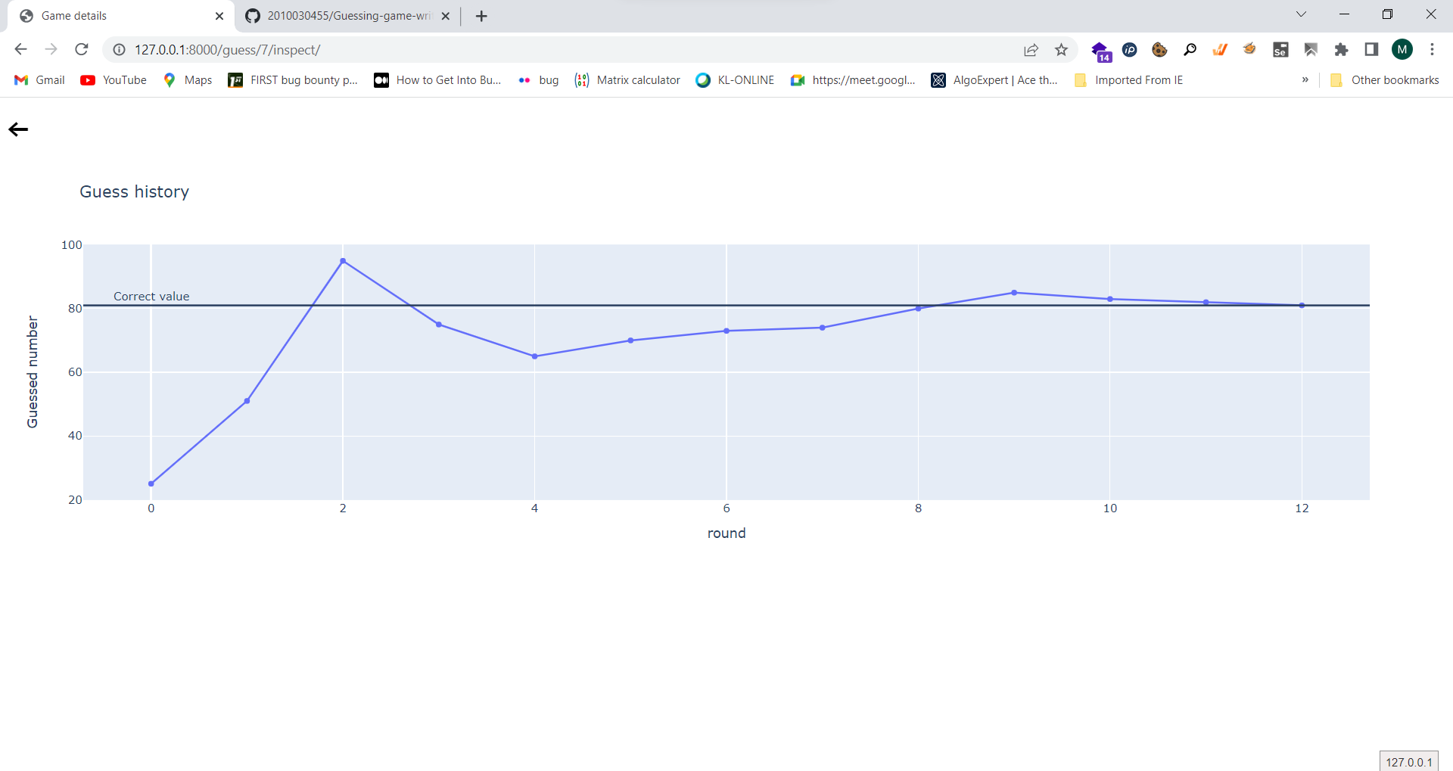
implementation

Slide 9
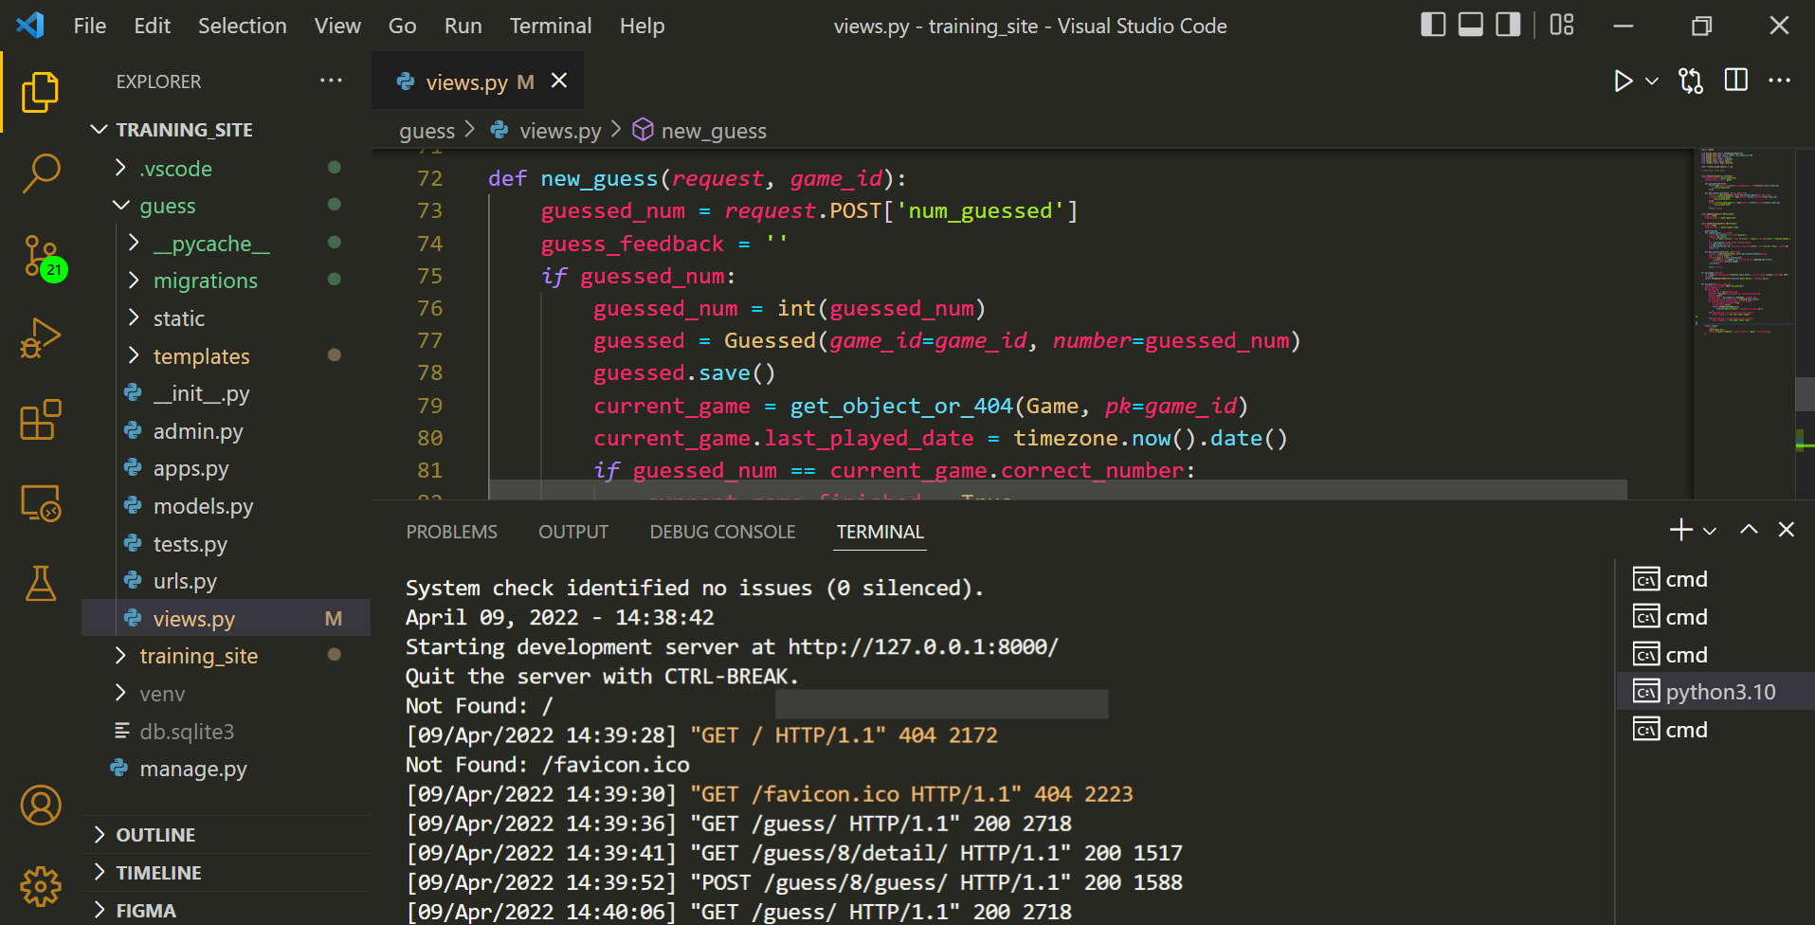
implementation

Slide 10
REFERENCES
https://nostarch.com/download/LearnJava_sample_ch2.pdf
http://reu.dimacs.rutgers.edu/~gautamr/idea1.pdf
https://www.researchgate.net/publication/237134049_A_Number-Guessing_Game
https://www.cs.cornell.edu/courses/cs211/2006fa/Sections/S7/bigo.pdf

Slide 11
THANK YOU

